Slide 1

Verification & Validation in Embedded Systems Testing
Understanding the fundamental processes that ensure embedded firmware quality, hardware-software integration, and reliability throughout the embedded development lifecycle.

Slide 2
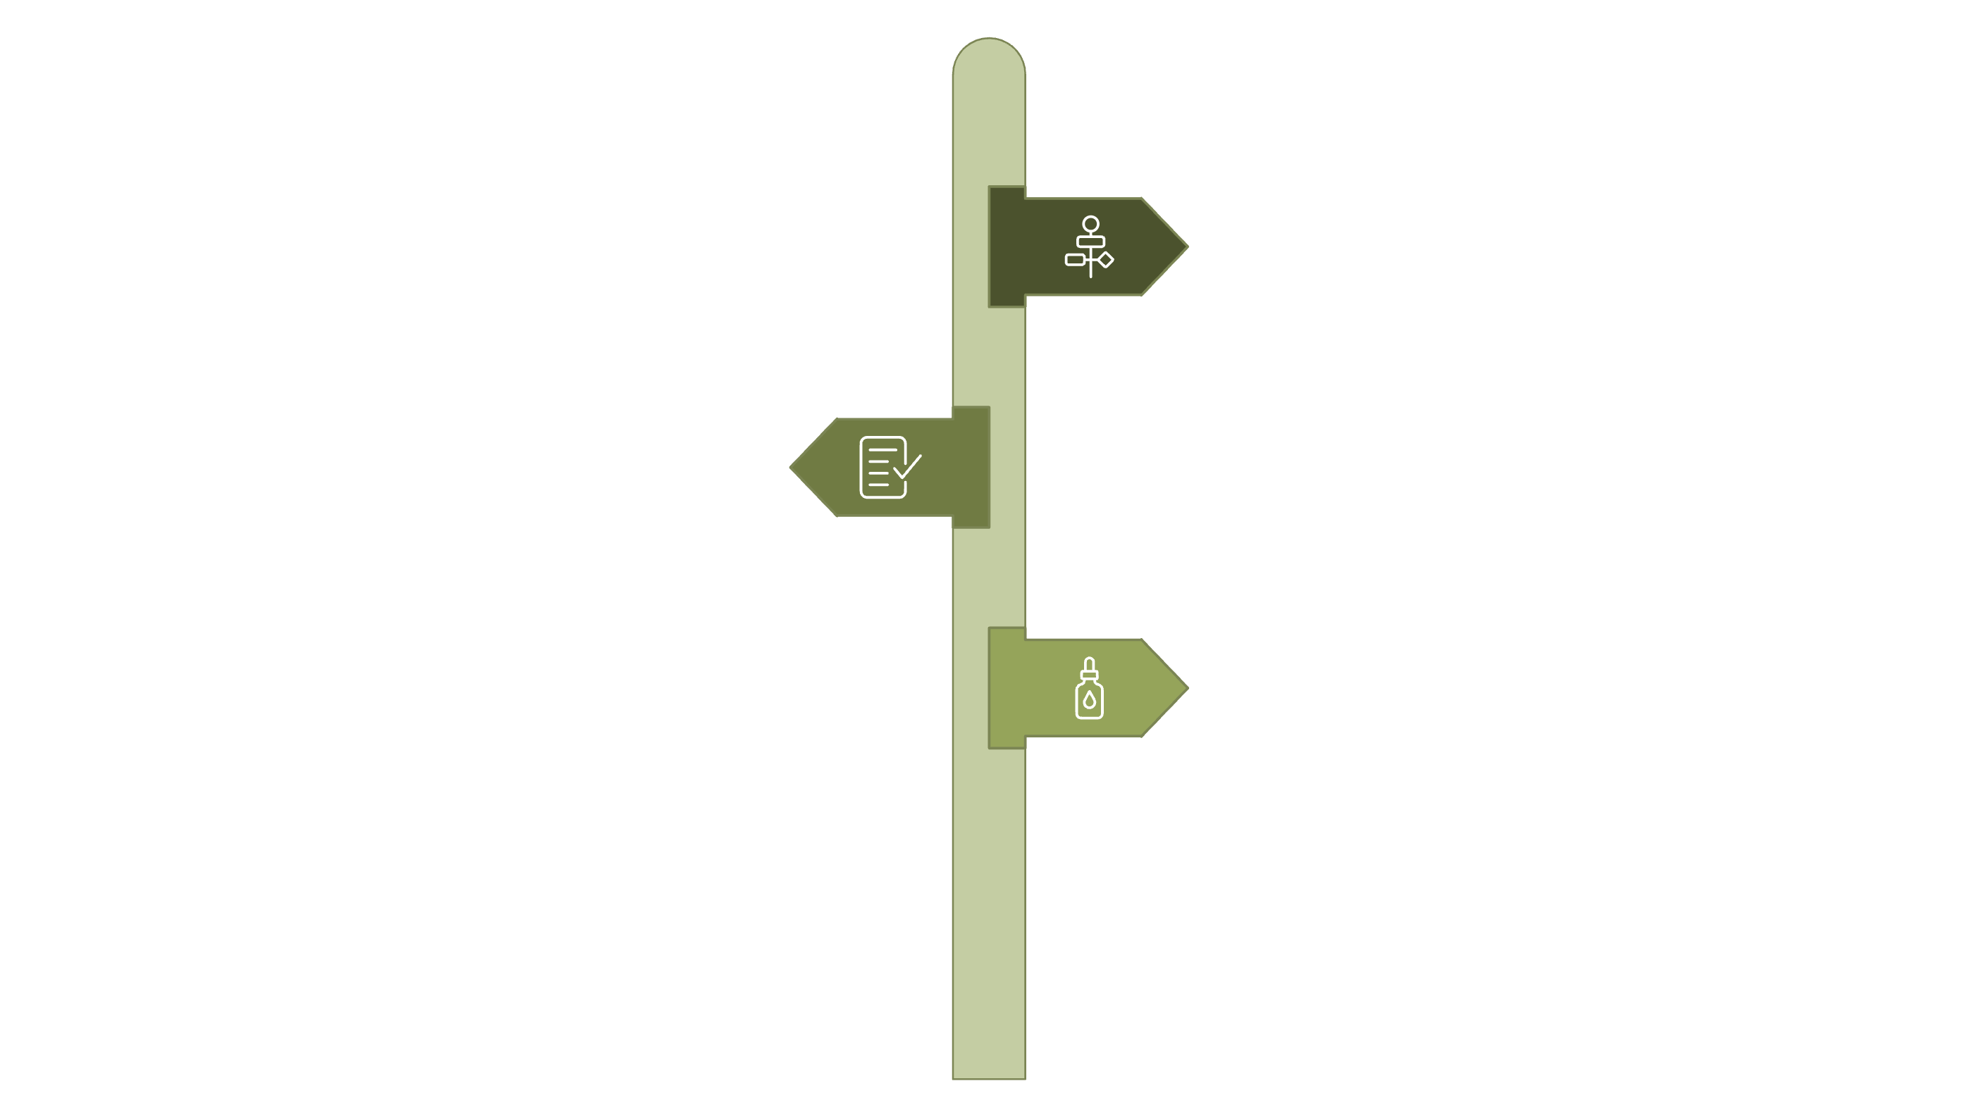



The SDLC Testing Hierarchy
SDLC
Development lifecycle stages
Verification
Ensure design correctness
Validation
Testing for requirements fit
Informal vs Formal Testing
This diagram outlines the sequential and branching stages of quality assurance within the Software Development Life Cycle (SDLC), emphasizing the distinct roles of verification and validation, and the dual nature of testing.

Slide 3

What is Verification?
The Process
Verification in embedded systems is the systematic process of ensuring that the firmware is built correctly according to specifications. It focuses on validating that the software is being developed accurately against its design and requirements.
This includes activities like code reviews, static analysis, design reviews, and hardware-software interface verification. It is performed throughout the firmware development phases and aims to prevent errors before critical hardware integration points.
Examples:
- Code review of interrupt handlers
- Verification of timing constraints
- Checking register configurations
Key Characteristics
Performed during firmware development phases
Focuses on code quality and design correctness
Prevents integration issues before hardware testing
Low-level activity (developer/team level)

Slide 4
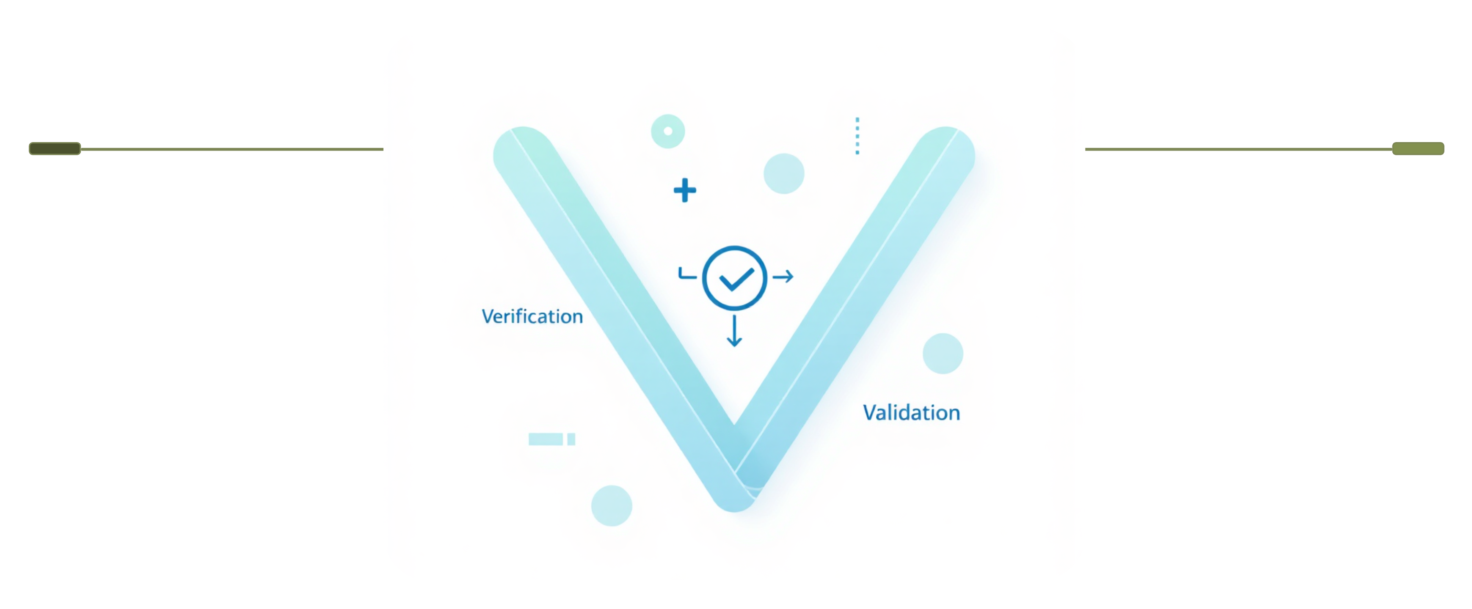
Verification & Validation: The Two Paths
Verification
Validation
Are we building the product right?
Are we building the right product?
This visual framework highlights the distinct yet interconnected roles of Verification and Validation in ensuring software quality and successful product delivery.

Slide 5
What is Validation?
ARE WE BUILDING THE RIGHT PRODUCT?
Validation ensures your software meets user needs and business requirements. It answers the critical question: Does the product do what users actually need?

Slide 6
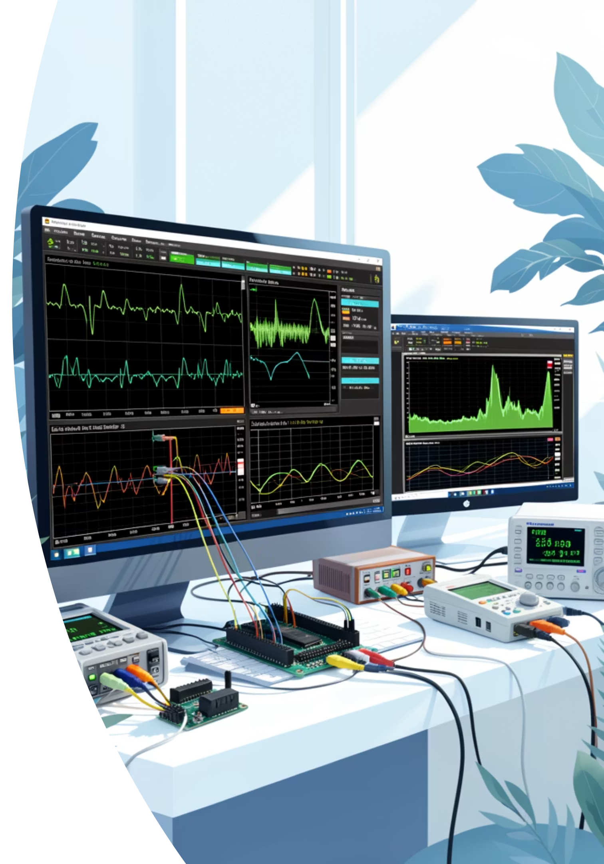



Validation…
High-Level Activity
After Integration
Ensures the embedded device meets actual requirements and works correctly in real environments, focusing on hardware-software integration.
Performed after firmware is integrated with hardware, verifying real-time performance, power consumption, and reliability.
Real-World Testing
Identifies issues in actual operating conditions, such as temperature, vibration, EMI, and confirms sensor accuracy.

Slide 7





Validation Activities
Unit Testing
Integration Testing
Testing individual firmware functions like sensor drivers, interrupt handlers, communication protocols
Testing interaction between firmware modules and hardware components
Verifying sensor-to-microcontroller communication, peripheral interactions
Ensures each module works correctly in isolation
System Testing
Acceptance Testing
Full end-to-end device testing (sensor input → processing → actuator output)
Real-world environmental testing (temperature, humidity, vibration, EMI)
Testing real-time performance, power consumption, thermal behavior
Verifying device meets performance specifications in actual deployment conditions

Slide 8





Real-Time Example: Validation Process
Embedded Systems - IoT Device Firmware
Unit Testing
Integration Testing
Focuses on individual firmware functions like readSensorData(), calculateTemperature(), controlMotor(). Each function correctly processes sensor inputs and returns expected outputs in isolation.
Verifies interaction between sensor module and microcontroller, or communication between different hardware components. Ensures modules communicate seamlessly and data flows correctly between hardware and firmware without errors.
System Testing
Acceptance Testing
Tests the full end-to-end device operation (sensor reading → processing → motor control → data transmission). The entire embedded system functions as a cohesive unit, meeting all hardware and firmware specifications.
Validates real-world scenarios, for example, "Device correctly reads temperature and adjusts fan speed within 2 seconds" or "Wireless transmission is reliable in target environment." Stakeholders confirm the embedded device meets performance requirements and works reliably in actual deployment conditions.

Slide 9
Formal vs. Informal Testing
Informal Testing
Formal Testing
When: During firmware development to verify code changes
When: After firmware-hardware integration, before product release
Why: Find bugs early, verify interrupt handling, check timing constraints
Why: Demonstrate device meets specifications and is safe for deployment
Requirements: No formal test plans needed
Requirements: Test plans, test procedures, environmental test specifications, formal reports
Examples: Unit testing firmware functions, quick hardware integration checks, debugging with oscilloscope
Examples: Environmental testing (temperature, humidity, vibration), EMC testing, reliability testing, safety validation

Slide 10

Essential Documentation
Test Plans
Test Procedures
Define testing scope, approach, resources, and schedule for formal testing activities.
Document step-by-step instructions for executing test cases consistently.
Discrepancy Records
Test Reports
Maintain logs of all bugs found, reported, and their resolution status.
Summarize testing progress, results, and metrics for stakeholders and management.
Critical: Without proper documentation, you cannot prove your work or defend against customer escalations. Maintain logs for every manual test case!

Slide 11


Key Differences
Verification
Validation
Are we building the firmware right?
Does the embedded device work correctly in real conditions?
Focuses on code quality, design correctness, and hardware-software interface specifications
Focuses on real-world performance, reliability, and environmental robustness
Verification Timing
Validation Timing
Before and during firmware development
After hardware-firmware integration
Low-level activity with development team
High-level activity requiring stakeholder approval
Prevention-focused
Rectification-focused

Slide 12




Conclusion: The Power of V&V in Embedded Systems
Verification and Validation are the twin pillars of quality in embedded systems, ensuring not just functionality, but robust performance and reliability in diverse conditions.
Build It Right
Build the Right Device
Verification ensures firmware is developed correctly according to specifications and best practices, preventing issues early in the development lifecycle.
Validation ensures the embedded device works reliably, meets user needs, and performs as expected in real-world conditions.
Integrated Throughout Development
Achieve Reliability
Both processes are essential, spanning from initial design and specification through hardware integration and final deployment.
Embrace V&V to deliver robust, reliable embedded systems that perform consistently, even in harsh environments.

Slide 13

Thank You!
V&V , together ensure software excellence and inspire a future of innovation.

